Slide 1
Optical communications and data networks (EENGM2001) Week14_Lecture011_ASync_LossBudget
Siddarth K Joshi

Slide 2
System perspective
Transmitter
Medium
Receiver
Laser/LED
Modulator
Optical Fibre
Free space
Photodiodes
Homo/heterodyne detectors
A loss budget accounts for all transmission powers, losses and receiver sensitivities
Will the system work?

Slide 3
Loss Budget
Transmitter
Medium
Receiver
Laser/LED
Modulator
Optical Fibre
Free space
Photodiodes
Homo/heterodyne detectors
Transmitter power:
peak
average
Transmitter noise power
Baud rate
Bit rate
Loss
Any amplifiers?
Other degradation to signal
Sensitivity
Noise & BER:
includes inter-symbol interference
De-modulation
The aim: to know the performance of the system and where a bottleneck is.

Slide 4
BER
BER = Bit Error Rate
Sometimes there are errors and we need to correct for them
Detecting Errors:
Add extra information to transmitted bits (e.g. Hamming code, Parity, Checksum, etc)
Correcting errors:
Add even more info to allow receiver to correct errors (if any) = Forward Error Correction
Allow receiver to ask for the data to be sent again.

Slide 5
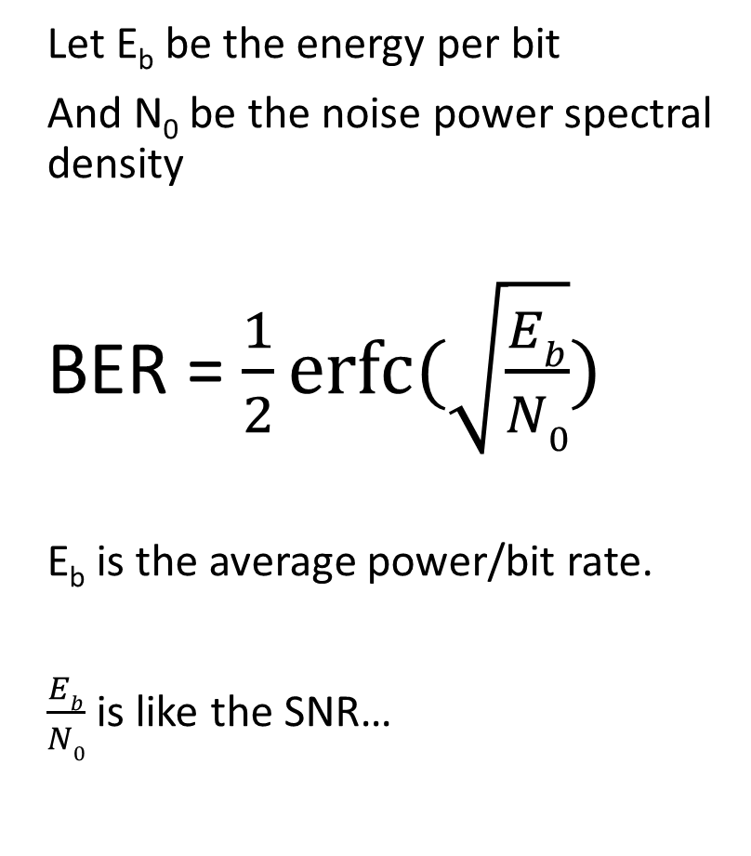
BER
BER = Bit Error Rate
Transmit : 1 1 0 0 0 1 0 1 1 0
But Receive: 0 1 0 1 0 1 0 0 1 0
BER = 3 bits or 30%
Let E_{b} be the energy per bit
And N₀ be the noise power spectral density
BER = $\frac{1}{2}erfc⁡(\sqrt{\frac{Eb}{N0}})$
E_{b} is the average power/bit rate.
$\frac{Eb}{N0}$ is like the SNR…
erfc is the complimentary error function. erfc(x) = 1-erf(x).
erf() is the error function. It is the mathematical name given to the integral of a gaussian.

Slide 6
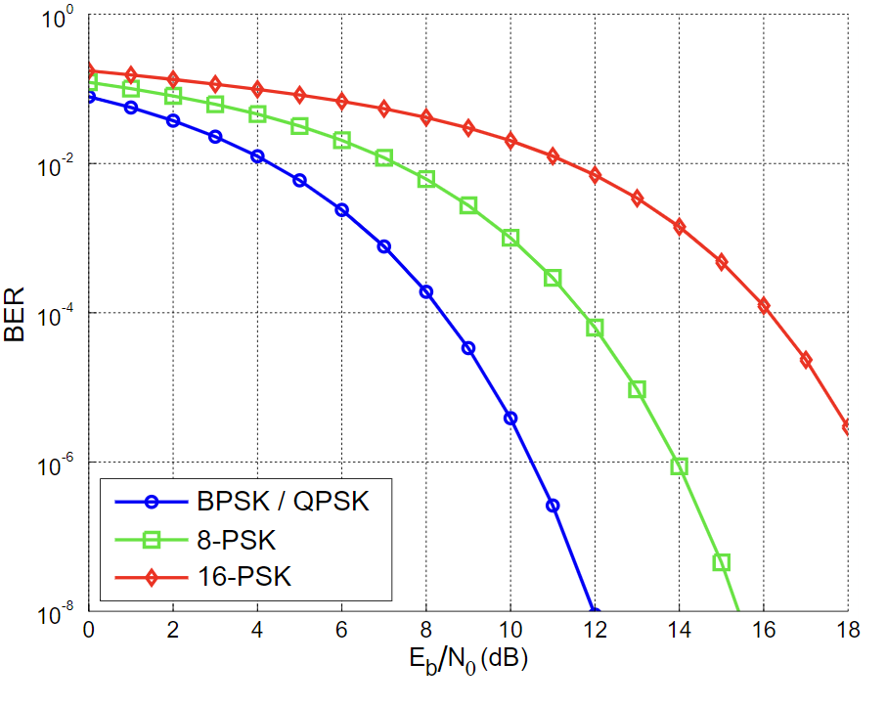
BER
Despite having the same SNR, different protocols have different BER
Difference between BPSK and QPSK too small to be seen on this graph.

Slide 7
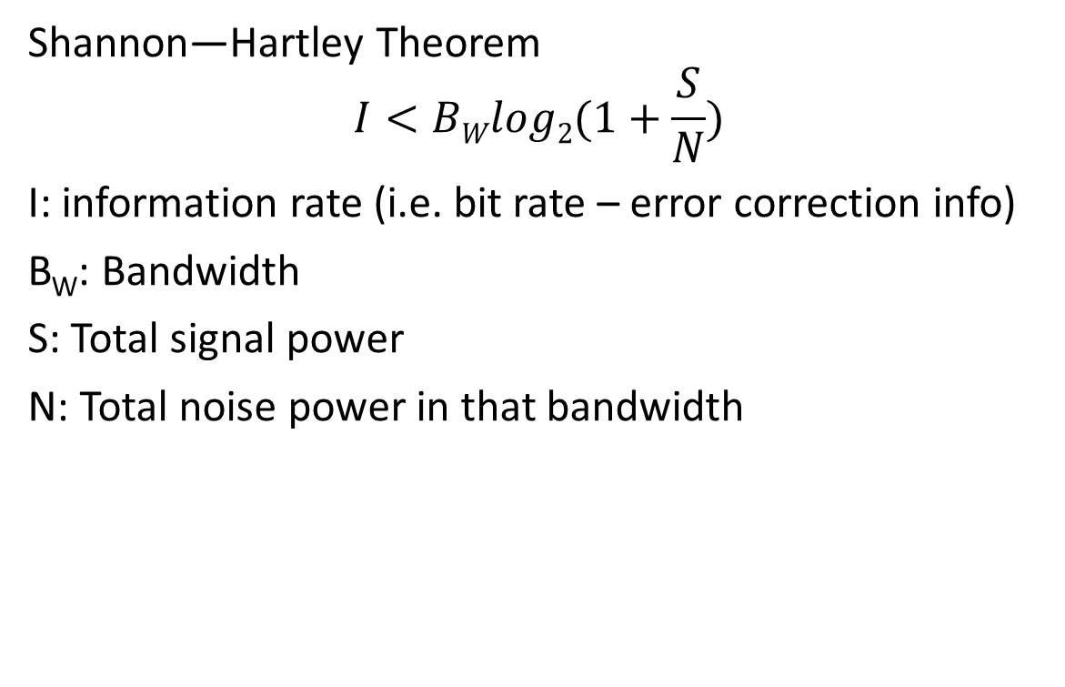
Shannon limit
Shannon—Hartley Theorem
$$I<BWlog2(1+\frac{S}{N})$$
I: information rate (i.e. bit rate – error correction info)
B_{W}: Bandwidth
S: Total signal power
N: Total noise power in that bandwidth
The limit of reliable information transfer depends on the bandwidth and SNR

Slide 8
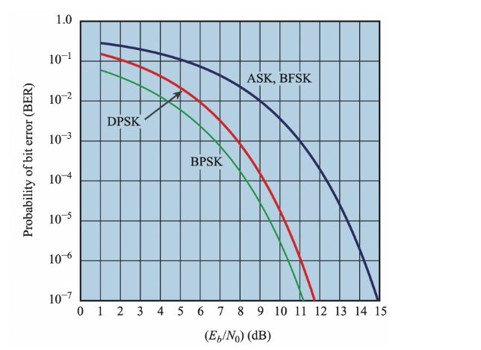
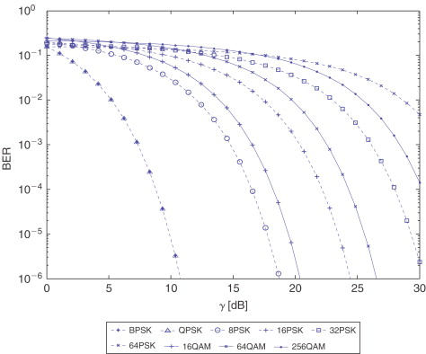
BER
BER < 1E-6 : excellent.
BER = ~1E-4 : Ok not so great.
BER > 1E-2: Bad

Slide 9
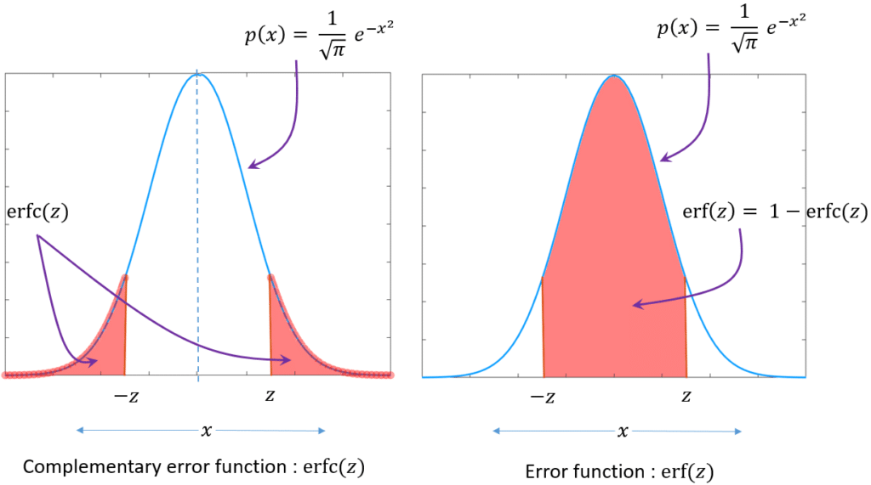
Erf

Slide 10
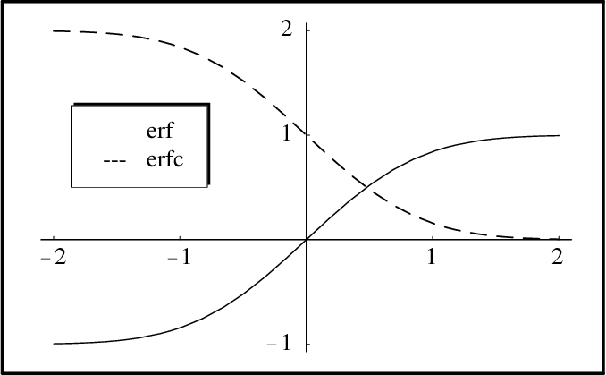
Erf

